Slide 1
Module 1: DIY Meals and Snacks
LESSON 1
THE BUILDING BLOCKS OF MEALS AND SNACKS
Notes:
Copyright © 2021 Dairy Farmers of Canada
Slide Intent: Introduce the lesson.
Teacher: Read the slide.
This slide deck contains embedded videos. To play videos directly from the slides, click “enable editing” and then click “enable content” on the top bar. Alternatively, you can use the Vimeo links in the notes section of the relevant slides to access the videos.

Slide 2
CHALLENGE
How can you use Canada’s Food Guide to plan and prepare enjoyable meals and snacks?
Notes:
Slide Intent: Review the CTF challenge for the DIY Meals and Snacks module.
Teacher: Read the slide.
Visit https://food-guide.canada.ca/en/ for more information on Canada’s Food Guide.

Slide 3
Notes:
Slide Intent: Highlight the application of Canada’s Food Guide.
Teacher: Here is another example of how to use Canada’s Food Guide to create a meal.
Note: The final foods shown are macaroni and cheese with broccoli and a mixed salad. If embedded video does not play, use the following Vimeo link to access the video: https://vimeo.com/465807860/ded57be32f

Slide 4
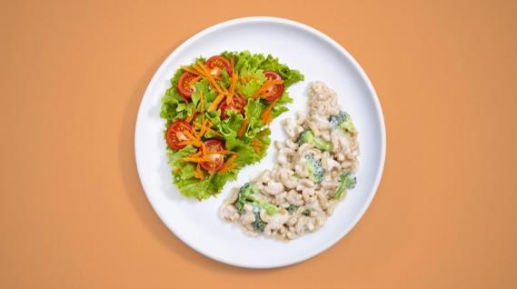
CANADA’S FOOD GUIDE IN ACTION
Notes:
Slide Intent: Highlight the application of Canada’s Food Guide. If you do not have an internet connection, show these image stills instead of the video.
Teacher: Here is another example of how to use Canada’s Food Guide to create a meal.
Note: The final foods shown are macaroni and cheese with broccoli and a mixed salad.

Slide 5
CANADA’S FOOD GUIDE
Foods from each category work together, like pieces of a puzzle, to provide important nutrients.
Choosing a variety of foods when we plan meals and snacks helps our bodies to get the nutrients we need to grow, think, and move.
Notes:
Slide Intent: Introducing CFG when planning meals and snacks.
Teacher: Read the slide.

Slide 6
CANADA’S FOOD GUIDE PLATE
Canada’s Food Guide identifies vegetables and fruits, whole grain foods, and protein foods as the foundation for meals and snacks.
Notes:
Slide Intent: Introducing the CFG Plate.
Teacher: Read the slide. Ask students to name vegetables and fruits, whole grain foods, and protein foods. Some possibilities:
- Vegetables and fruits (apple, orange, banana, spinach, lettuce, bell peppers, etc.)
- Whole grain foods (bread, pasta, rice, couscous, oats, etc.)
- Protein foods (milk, yogurt, cheese; fish, seafood, meat; pulses, nuts, seeds, etc.)

Slide 7
WHAT ABOUT BEYOND CANADA’S FOOD GUIDE FOODS?
Foods from beyond Canada’s Food Guide, such as your favourite dip or cookie, can make meals and snacks taste even better and provide satisfaction and enjoyment.
Notes:
Slide Intent: Discuss foods from outside the CFG Plate.
Teacher: You will notice that the CFG Plate does not include all foods we eat. For example, foods such as spices, chocolate, and dips aren’t found on the Plate but they do play an important role in eating. They often make our meals and snacks taste better and provide satisfaction and enjoyment.
Note: You can help students feel relaxed and supported by talking about all foods in a neutral way. This includes talking about food without using labels such as “healthy” versus “unhealthy” or “good foods” versus “bad foods.” Read more about this approach in the Teacher Guide under How to Talk about Food with Students, p. 18.

Slide 8
PLANNING MEALS
When planning meals, select at least one food from each Canada’s Food Guide category:
Vegetables and fruits
Whole grain foods
Protein foods
Notes:
Slide Intent: How to plan meals.
Teacher: Read the slide. This meal includes roasted cauliflower (vegetable), whole grain naan (whole grain food) and chana masala (chickpeas, a protein food).

Slide 9
PLANNING SNACKS
To get started, when planning snacks select foods from at least two of the Canada’s Food Guide categories:
Vegetables and fruits
Whole grain foods
Protein foods
Notes:
Slide Intent: How to plan snacks.
Teacher: Read the slide. This snack includes grapes (fruit) and nuts (protein food).

Slide 10
KEEP IN MIND…
What matters most is how and what you eat over time, and how that makes you feel, rather than following a precise meal or snack structure every single day.
Notes:
Slide Intent: Encourage a positive relationship with food.
Teacher: There is no such thing as a “perfect” or “correct” meal or snack. What matters most is how and what you eat over time, rather than following a precise meal or snack structure every single day.
Note: While this Foods module includes discussion about nutrients and the benefits of eating a variety of foods, we encourage neutral food exposure and conversation about all foods to preserve and foster a positive relationship with food. Neutral food conversations mean there is no judgement of the food or the person eating the food. Being mindful of how health messages are delivered and avoiding techniques such as food tracking and food monitoring are recommended to minimize the risk of disordered eating behaviour that is associated with these practices.¹
¹Pinhas et al. Trading health for a healthy weight: the uncharted side of healthy weights initiatives. Eat Disord 2013;21:109-116.

Slide 11
ACTIVITY: BUILD-YOUR-OWN MEALS AND SNACKS
Notes:
Slide Intent: Optional whole class activity.
Teacher: Show the slide for students to view, assess, and record answers on their worksheet. Activity sheets are included in the Student Workbook.

Slide 12
SNACK 1: Orange slices
Notes:
Slide Intent: Optional whole class activity.
Teacher: Show the slide for students to view, assess, and record answers on their worksheet.

Slide 13
SNACK 2: Yogurt and berries
Notes:
Slide Intent: Optional whole class activity.
Teacher: Show the slide for students to view, assess, and record answers on their worksheet.

Slide 14
BREAKFAST 1: Whole grain English muffin with strawberry jam, and a glass of water
Notes:
Slide Intent: Optional whole class activity.
Teacher: Show the slide for students to view, assess, and record answers on their worksheet.

Slide 15
BREAKFAST 2: Scrambled eggs, whole grain toast, and a glass of milk
Notes:
Slide Intent: Optional whole class activity.
Teacher: Show the slide for students to view, assess, and record answers on their worksheet.

Slide 16
LUNCH 1: Vegetarian chili, whole grain bun, and a glass of milk
Notes:
Slide Intent: Optional whole class activity.
Teacher: Show the slide for students to view, assess, and record answers on their worksheet.

Slide 17
LUNCH 2: Grilled cheese sandwich on whole grain bread, bell peppers, dip, and a glass of water
Notes:
Slide Intent: Optional whole class activity.
Teacher: Show the slide for students to view, assess, and record answers on their worksheet.

Slide 18
SUPPER 1: Whole grain pasta with tomato sauce, salad, cupcake, and a glass of water
Notes:
Slide Intent: Optional whole class activity.
Teacher: Show the slide for students to view, assess, and record answers on their worksheet.

Slide 19
SUPPER 2: Moose stew, carrot sticks, and a glass of milk
Notes:
Slide Intent: Optional whole class activity.
Teacher: Show the slide for students to view, assess, and record answers on their worksheet.

Slide 20
ANSWER KEY: Orange slices
Notes:
Slide Intent: Answer key
Teacher: VF (orange); need to add one food category (WGF or PF)
Invite students to share their responses to questions 2 and 3.
Would you swap out any foods for something you like better while keeping at least two out of the Canada’s Food Guide categories (vegetables and fruits, whole grain foods, and/or protein foods)?
Would you add anything else to the snack or meal to make it taste even better?

Slide 21
ANSWER KEY: Yogurt and berries
Notes:
Slide Intent: Answer key
Teacher: VF (berries), PF (yogurt); contains two food categories
Invite students to share their responses to questions 2 and 3.
Would you swap out any foods for something you like better while keeping at least two out of the Canada’s Food Guide categories (vegetables and fruits, whole grain foods, and/or protein foods)?
Would you add anything else to the snack or meal to make it taste even better?

Slide 22
ANSWER KEY: Whole grain English muffin with strawberry jam, and a glass of water
Notes:
Slide Intent: Answer key
Teacher: WGF (English muffin); need to add two food categories (VF and PF)
Note the strawberry jam does not need to be removed for the meal to be balanced (see Roles Foods Play in Eating and Life in the Teacher Guide, p. 18)
Invite students to share their responses to questions 2 and 3.
Would you swap out any foods for something you like better while keeping at least one vegetable or fruit, one whole grain food, and one protein food?
Would you add anything else to the snack or meal to make it taste even better?

Slide 23
ANSWER KEY: Scrambled eggs, whole grain toast, and a glass of milk
Notes:
Slide Intent: Answer key
Teacher: WGF (whole grain toast), PF (milk, eggs); need to add one food category (VF)
Invite students to share their responses to questions 2 and 3.
Would you swap out any foods for something you like better while keeping at least one vegetable or fruit, one whole grain food, and one protein food?
Would you add anything else to the snack or meal to make it taste even better?

Slide 24
ANSWER KEY: Vegetarian chili, whole grain bun, and a glass of milk
Notes:
Slide Intent: Answer key
Teacher: VF (celery, corn, carrots in chili), WGF (whole grain bun), PF (milk, mixed beans); contains all three food categories
Invite students to share their responses to questions 2 and 3.
Would you swap out any foods for something you like better while keeping at least one vegetable or fruit, one whole grain food, and one protein food?
Would you add anything else to the snack or meal to make it taste even better?

Slide 25
ANSWER KEY: Grilled cheese sandwich on whole grain bread, bell peppers, dip, and a glass of water
Notes:
Slide Intent: Answer key
Teacher: VF (bell peppers), WGF (whole grain bread), PF (cheese); contains all three food categories
Note the dip does not need to be removed for the meal to be balanced (see Roles Foods Play in Eating and Life in the Teacher Guide, p. 18)
Invite students to share their responses to questions 2 and 3.
Would you swap out any foods for something you like better while keeping at least one vegetable or fruit, one whole grain food, and one protein food?
Would you add anything else to the snack or meal to make it taste even better?

Slide 26
ANSWER KEY: Whole grain pasta with tomato sauce, salad, cupcake, and a glass of water
Notes:
Slide Intent: Answer key
Teacher: VF (tomato sauce, salad), WGF (whole wheat pasta); need to add one food category (PF)
Note the cupcake does not need to be removed for the meal to be balanced (see Roles Foods Play in Eating and Life in the Teacher Guide, p. 18)
Invite students to share their responses to questions 2 and 3.
Would you swap out any foods for something you like better while keeping at least one vegetable or fruit, one whole grain food, and one protein food?
Would you add anything else to the snack or meal to make it taste even better?

Slide 27
ANSWER KEY: Moose stew, carrot sticks, and a glass of milk
Notes:
Slide Intent: Answer key
Teacher: VF (carrots sticks; potato, celery, carrots in stew), PF (milk, moose); need to add one food category (WGF)
Invite students to share their responses to questions 2 and 3.
Would you swap out any foods for something you like better while keeping at least one vegetable or fruit, one whole grain food, and one protein food?
Would you add anything else to the snack or meal to make it taste even better?

Slide 28
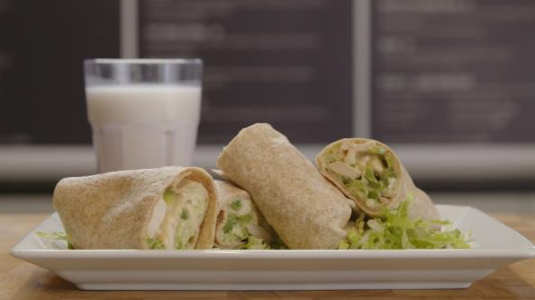
RECIPE: HONEY MUSTARD CHICKEN WRAPS
Notes:
Slide Intent: Introduce the recipe.
Teacher: The two recipes for this lesson are Honey Mustard Chicken Wraps (simple) and Macaroni and Cheese with Broccoli (complex). You can decide if you would like to use one or both of the recipes.

Slide 29
Notes:
Slide Intent: Video cooking demonstration: Honey Mustard Chicken Wraps.
Teacher: This video highlights key elements of creating Honey Mustard Chicken Wraps. Consider discussing the following with students:
Food safety practices when handling raw meat (e.g., separate cutting board)
Best practices when cooking/heating milk (low heat, add slowly)
Knife safety when cutting vegetables
Vegetarian variation, swapping chickpeas for the chicken
Note: If embedded video does not play, use the following Vimeo link to access the video: https://vimeo.com/480813088/4e901b3a28

Slide 30
Notes:
Slide Intent: Provide an overview of the recipe.
Teacher: The recipe is also included in the Student Workbook for students to follow along. Highlight any relevant points for students.

Slide 31
Notes:
Slide Intent: Provide an overview of the recipe.
Teacher: The recipe is also included in the Student Workbook for students to follow along. Highlight any relevant points for students.

Slide 32
Notes:
Slide Intent: Provide an overview of the recipe.
Teacher: The recipe is also included in the Student Workbook for students to follow along. Highlight any relevant points for students.

Slide 33
Notes:
Slide Intent: Provide an overview of the recipe.
Teacher: The recipe is also included in the Student Workbook for students to follow along. Highlight any relevant points for students.

Slide 34
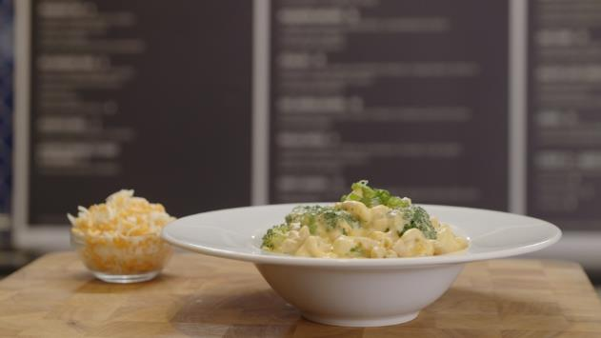
RECIPE: MACARONI AND CHEESE WITH BROCCOLI
Notes:
Slide Intent: Introduce the recipe.
Teacher: The two recipes for this lesson are Honey Mustard Chicken Wraps (simple) and Macaroni and Cheese with Broccoli (complex). You can decide if you would like to use one or both of the recipes.

Slide 35
Notes:
Slide Intent: Video cooking demonstration: Macaroni and Cheese With Broccoli.
Teacher: This video highlights key elements of creating Macaroni and Cheese with Broccoli. Consider discussing the following with students:
How to steam vegetables
Basic ingredients of a roux and how to prepare it (flour and butter; low heat and add milk slowly)
Other recipes a roux can be used in (e.g., gumbo)
Basic steps of cooking pasta and the term “al dente” (tender-firm)
Note: If embedded video does not play, use the following Vimeo link to access the video: https://vimeo.com/480817034/03654ecf0d

Slide 36
Notes:
Slide Intent: Provide an overview of the recipe.
Teacher: The recipe is also included in the Student Workbook for students to follow along. Highlight any relevant points for students.

Slide 37
Notes:
Slide Intent: Provide an overview of the recipe.
Teacher: The recipe is also included in the Student Workbook for students to follow along. Highlight any relevant points for students.

Slide 38
Notes:
Slide Intent: Provide an overview of the recipe.
Teacher: The recipe is also included in the Student Workbook for students to follow along. Highlight any relevant points for students.

Slide 39
Notes:
Slide Intent: Provide an overview of the recipe.
Teacher: The recipe is also included in the Student Workbook for students to follow along. Highlight any relevant points for students.

